Slide 1
CPSC - 8650
DATA MINING
Manasa Thatipamula
Uma Maheswara Rao Meleti
Trinath Sai Subhash Reddy Pittala

Slide 2
Introduction
The project tackles age-related hearing loss; we used a combination of deep learning and standard machine learning models to predict hearing thresholds at two different frequencies.
We used the given brain MRI images volumes to train our models. The models will unlock the features of given images in high dimensional space and predict the hearing thresholds.
We experimented with variational autoencoders (VAEs) and autoencoders (AEs) to reduce high dimensional 3D volume into rich latents to provide input to secondary regression models for threshold prediction.
Our training methodology involves two phases: in the first phase, the autoencoder is trained for reconstructing the augmented input images, and the second phase uses the latent of the trained autoencoder to train the regression model.
Notes:
The project is about age related hearing loss. We have given hearing thresholds at 2 different frequencies. We trained our models with the given brain MRI images. Our models showcased the features of the images in high dimensional spaces. We mainly experimented with VAE and AE to reduce high dimensional 3D volume into rich latents which then were given as an input to secondary regression models for threshold prediction. There are 2 phases in our training methodology. The first phase includes reconstruction of augmented input images and in the second phase we trained a regression model with latents obtained on images using autoencoder trained in the first phase.

Slide 3
Data
The data set consists of 171 Grey Matter Magnetic Resonance Images (MRI), with 137 slices of human brain scans
Every image has corresponding PT500 and PT4000 threshold values
PT500 is the threshold (in db) for a specific person from which point the person is able to hear 500 Hz sounds
PT4000 is the threshold (in db) for a specific person from which point the person is able to hear 4000 Hz sounds

Slide 4
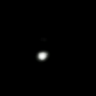
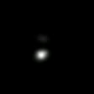
Methodology
Phase - 1
3D Auto Encoder
Augmented Image (80%)
Original (20%)
Recovered Original Image

Slide 5
Phase - 2
Trained 3D Auto Encoder
Auto encoder with 3D convolutions and Resnet Blocks
Original Image
Secondary Regression Model
Latents
Prediction

Slide 6
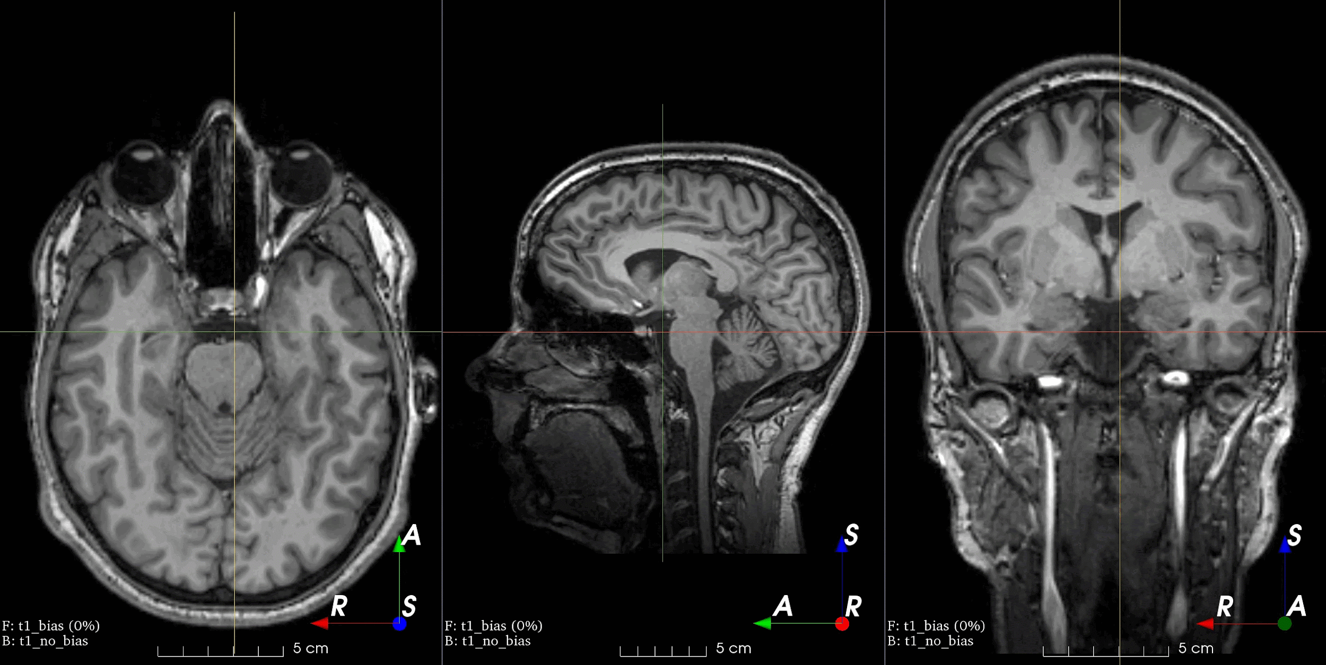
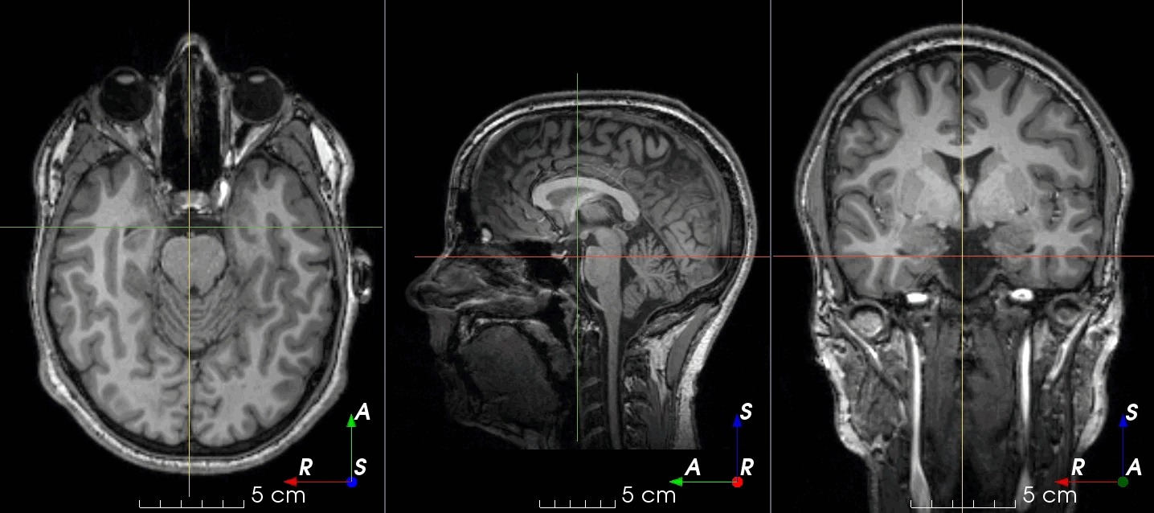
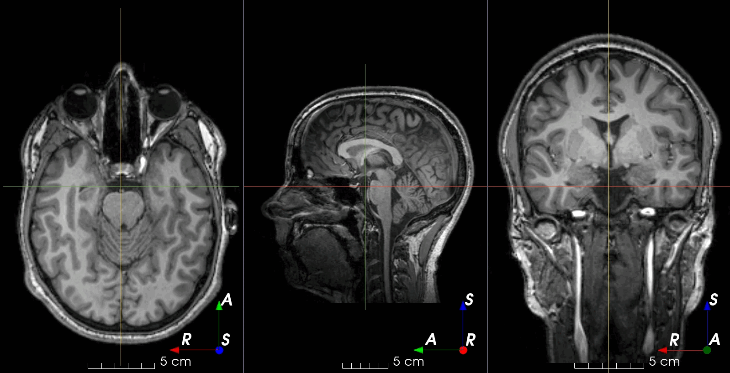
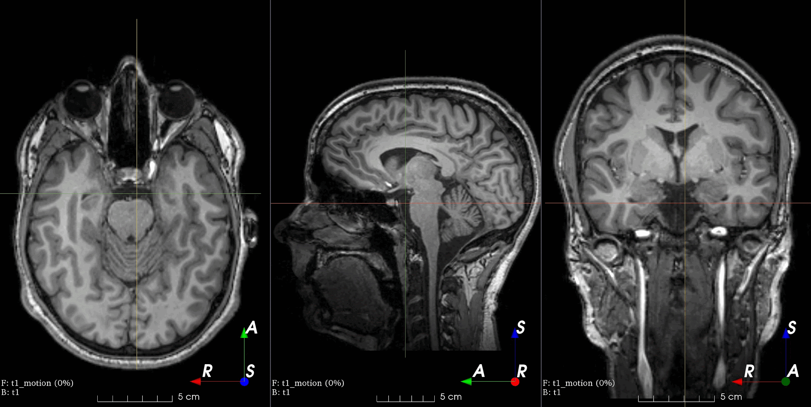
Data Augmentation
RandomBIasField
RandomSpike
RandomGhosting
RandomMotion
Notes:
RandomBIasField: Add random MRI bias field artifact. MRI magnetic field inhomogeneity creates intensity variations of very low frequency across the whole image.
RandomSpike: Add random MRI spike artifacts. Also known as Herringbone artifact, crisscross artifact or corduroy artifact, it creates stripes in different directions in image space due to spikes in k-space.
RandomGhosting: Add random MRI ghosting artifact. Discrete “ghost” artifacts may occur along the phase-encode direction whenever the position or signal intensity of imaged structures within the field-of-view vary or move in a regular (periodic) fashion.
RandomMotion: Add random MRI motion artifact. Magnetic resonance images suffer from motion artifacts when the subject moves during image acquisition.

Slide 7
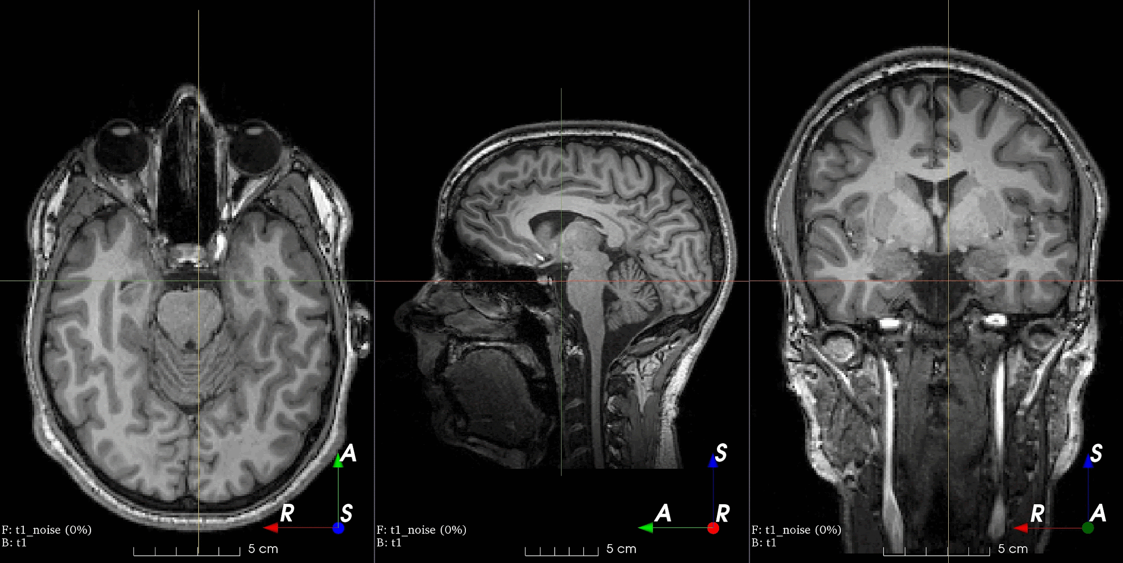
RandomNoise
RandomGamma: Randomly change contrast of an image by raising its values to the power .
RandomBlur: Blur an image using a random-sized Gaussian filter.
https://torchio.readthedocs.io/transforms/augmentation.html
Notes:
RandomNoise: Add Gaussian noise with random parameters. Add noise sampled from a normal distribution with random parameters.

Slide 8
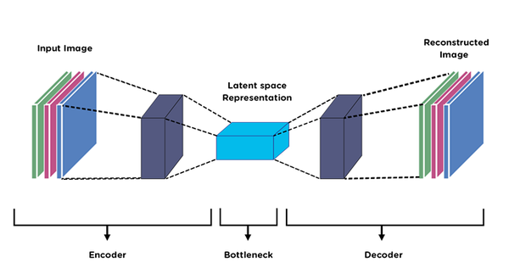
Autoencoders
Data-specific: They are trained to reconstruct only the data similar to what they have been trained on, making them specific to the input data's characteristics.
Dimensionality reduction: Autoencoders can reduce the dimensionality of data by learning to ignore noise and retaining only the most important features.
Feature learning: They learn to encode the input data into a set of features in an unsupervised manner, which can then be used for various tasks like classification.
Reconstruction Loss: The training of an autoencoder is guided by the reconstruction loss, which measures how well the output matches the original input.
Ref - https://medium.com/@birla.deepak26/autoencoders-76bb49ae6a8f

Slide 9
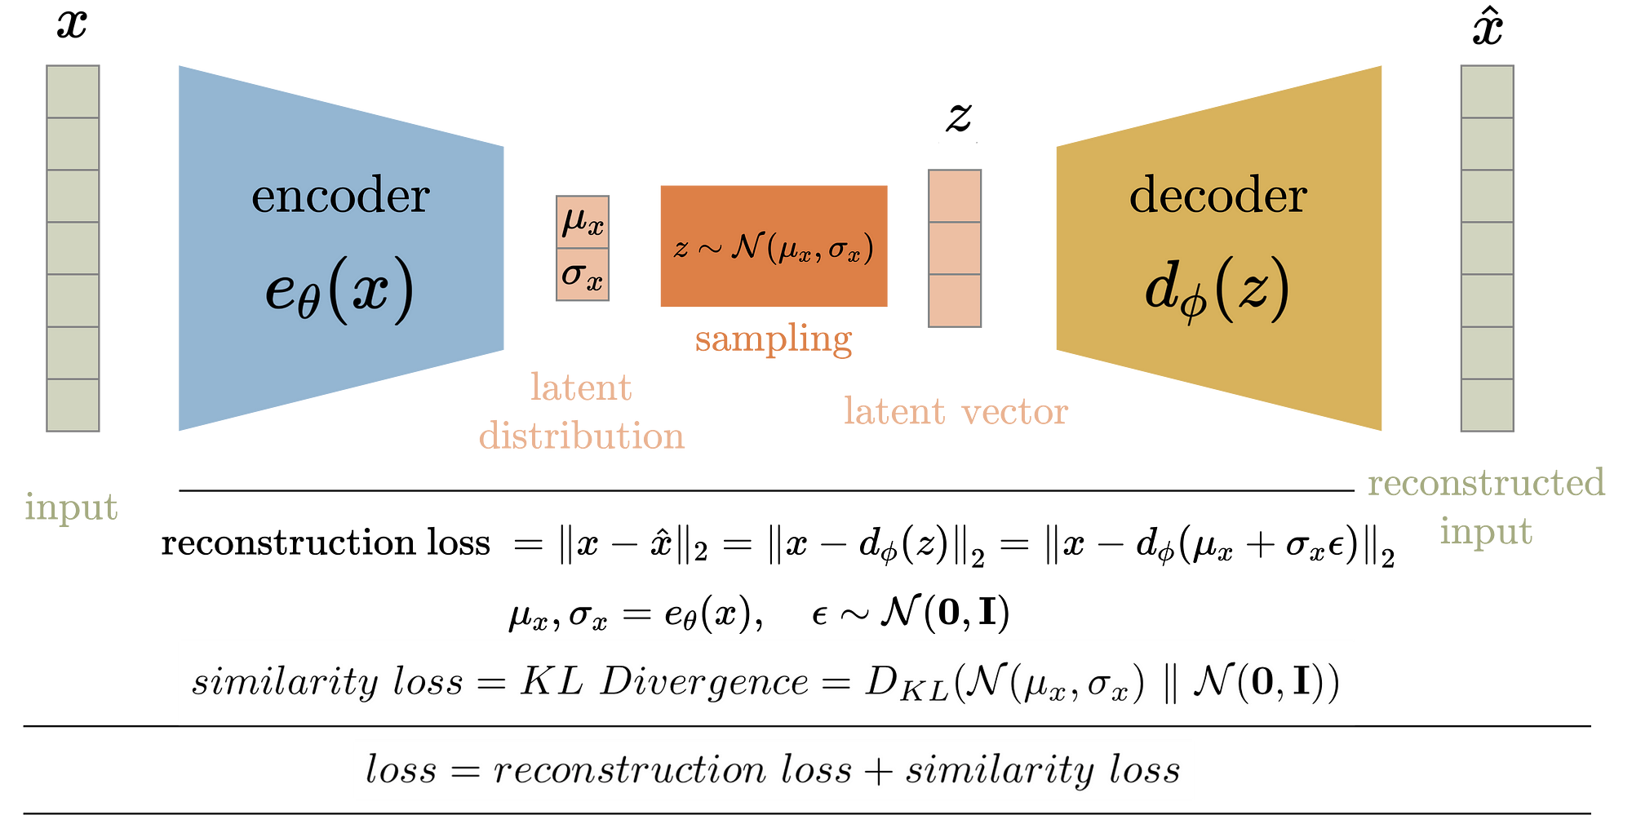
Variational Autoencoders
Probabilistic Latent Space: Unlike traditional autoencoders, VAEs map inputs to a distribution over the latent space, which adds a probabilistic twist to the encoding process.
Generative Model: VAEs are generative models, meaning they can generate new data that is similar to the training data, which makes them useful for tasks like image generation.
Regularization: They include a regularization term in their loss function, which ensures that the learned latent space is continuous, thus enabling the generation of new samples.
Bayesian Inference: VAEs use Bayesian methods to infer the latent variable model, allowing them to deal with uncertainty and variability in the data effectively.
https://towardsdatascience.com/difference-between-autoencoder-ae-and-variational-autoencoder-vae-ed7be1c038f2

Slide 10
Building Blocks
Conv3D
Conv Block
Batch Norm
Conv Block
Relu
Auto encoder with 3D convolutions and Resnet Blocks
Conv Block
Resnet Block
Conv Block + Resent Block

Slide 11

Reconstructed Output
Input
Autoencoder Reconstruction
Variational Autoencoder Reconstruction

Slide 12
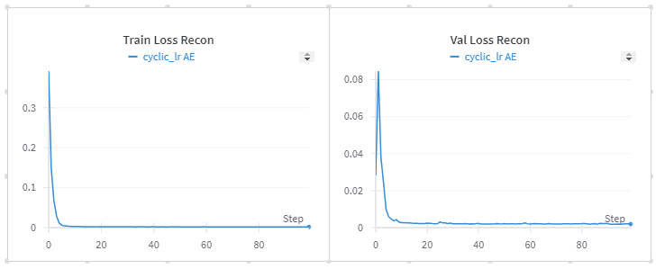
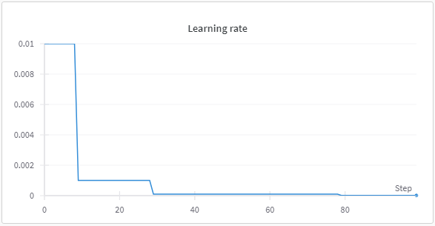
Training Graphs (AutoEncoder, L2 reconstruction loss)

Slide 13
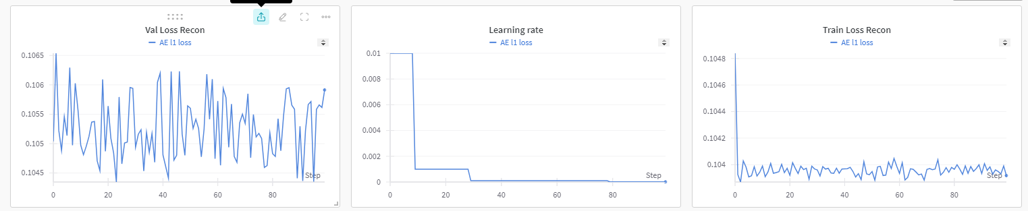
Training Graphs (AutoEncoder, L1 reconstruction loss)

Slide 14
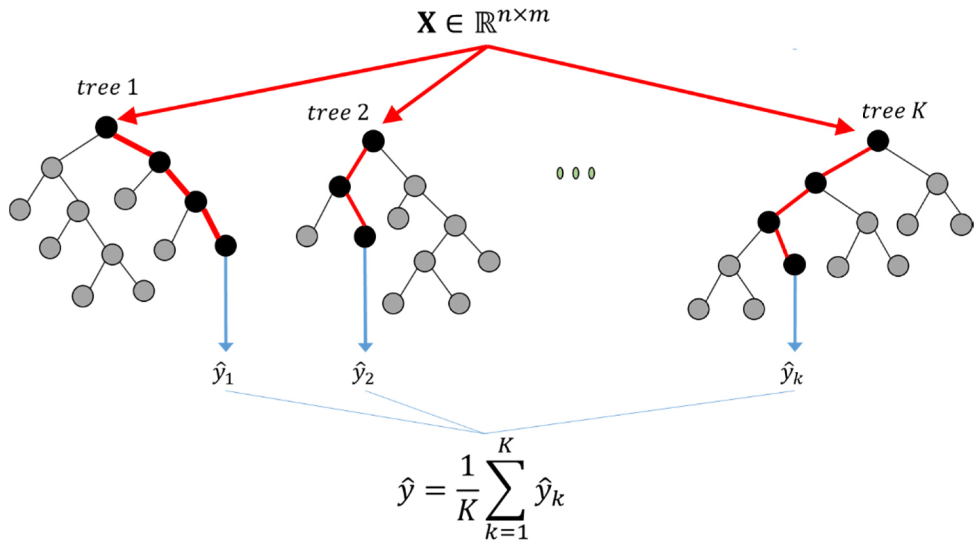
Secondary Regression Models
Random Forest on Latents:
This model uses the Random Forest algorithm, which operates by constructing multiple decision trees during training and outputting the mode of the classes (classification) or mean prediction (regression) of the individual trees.

Slide 15
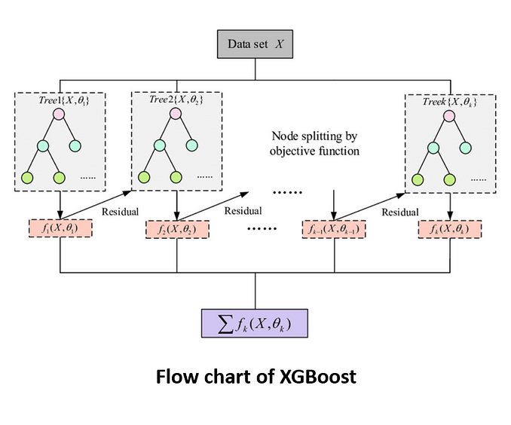
XGBoost on Latents:
XGBoost (Extreme Gradient Boosting) is an advanced implementation of gradient boosted trees designed for speed and performance. When XGBoost is applied to latent features, it aims to leverage these compact, informative representations of the data to improve prediction accuracy, by sequentially building trees that correct the predecessor's errors.

Slide 16
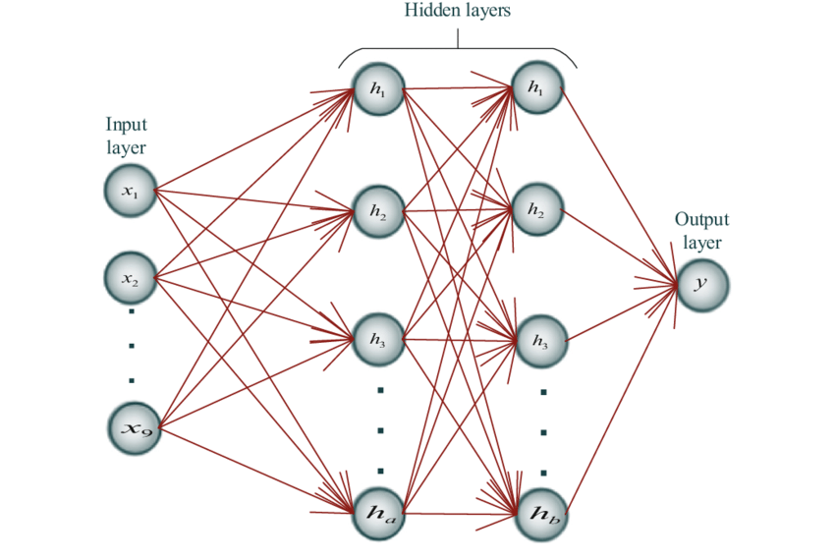
MNN on Latents:
MNN, or Multi Neural Network, refers to a model Simple Neural Network with 2 hidden layers. This approach can be advantageous for modeling non-linear complexities and interactions within the data. Using MNN on latent features suggests an enhanced focus on leveraging deeply extracted features to capture patterns more effectively.

Slide 17
Regression Model results
 | RMSE of PT500 (AE Latents) using L2 loss | RMSE of PT4000 (AE Latents) using L2 loss
Random Forest on Latents | 9.2287 | 22.8441
XGBoost on Latents | 9.5331 | 24.3296
MNN on Latents | 8.8057 | 22.5222
Ensemble of MNN and XGBoost on Latents | 9.4629 | 25.9908

Slide 18
Conclusion
Best Performance: The Multi Neural Network (MNN) model achieved the lowest RMSE values among the individual models for both PT500 and PT4000, indicating better performance in capturing the underlying patterns of the data.
Comparison of Models: XGBoost performed slightly worse than the Random Forest for PT500 and PT4000, suggesting that the Random Forest might be better for this particular dataset when used on latent features.
Ensemble Results: The ensemble model combining MNN and XGBoost did not improve results; in fact, it recorded the highest RMSE for PT4000 among all tested approaches, which could indicate overfitting or poor synergy between the model predictions.
Overall Analysis: Among the models tested using AE latents, the standalone MNN model proved to be the most effective in terms of minimizing the RMSE, suggesting that it might be the best choice for similar types of data in future applications.
Limited Dataset: The limited amount of data (171 images) leads to more inconclusive results.

Slide 19
References
https://torchio.readthedocs.io/transforms/augmentation.html -
https://medium.com/@birla.deepak26/autoencoders-76bb49ae6a8f
https://towardsdatascience.com/difference-between-autoencoder-ae-and-variational-autoencoder-vae-ed7be1c038f2

Slide 20
THANK YOU

